Slide 1
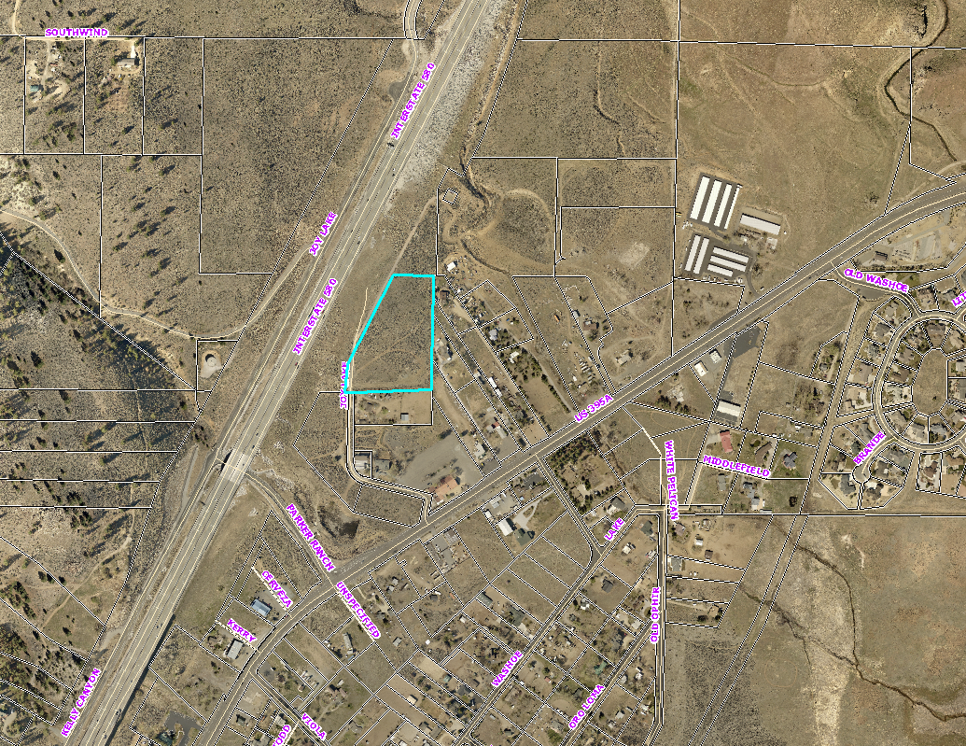
WSUP18-0014 Madole Construction
Washoe County Board of Adjustment
August 2, 2018

Slide 2
Request
Located at 0 Joy Lake in the Old Washoe City Historic District.
The application is requesting Construction Sales and Services and Operable Vehicle Storage.
Both uses require an SUP per the South Valleys Area Plan.

Slide 3
Modification Request
The proposal also requests to modify two sections of the Washoe County Code.
119.412.40 (b) Required Yards Adjoining Streets
1 tree every 50 linear feet along the right-of-way.
110.412.40 (c) and 110.412.40 (d) – Landscape Buffers and Screening Adjoining Residential Uses.

Slide 4
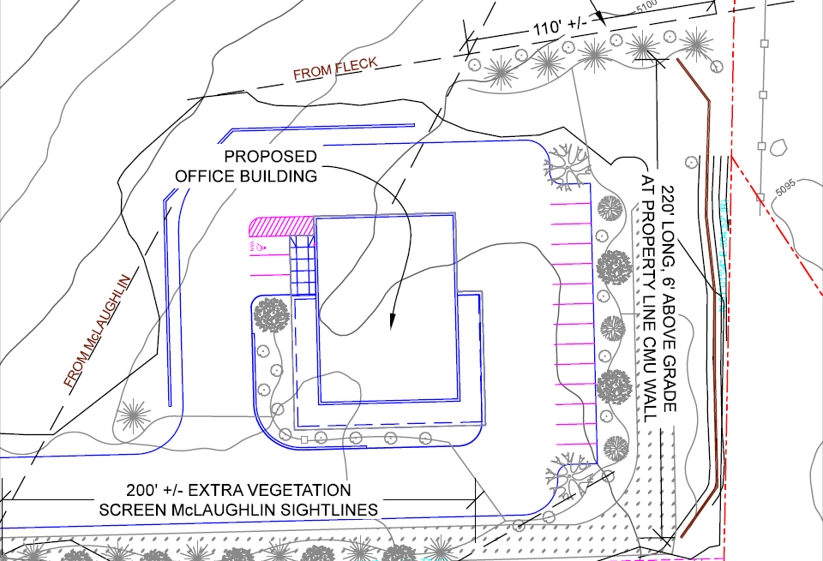
Modification

Slide 5
Background
The subject property has a regulatory zone of General Commercial (GC)
The subject property has a master plan category of Commercial (C)
5.61 acres

Slide 6
Analysis
Building maintenance company
Proposed office with attached garage/shop
Attached garage/shop is intended for storage of supplies and tools; not intended for receiving goods
17 parking spaces
No phased construction

Slide 7
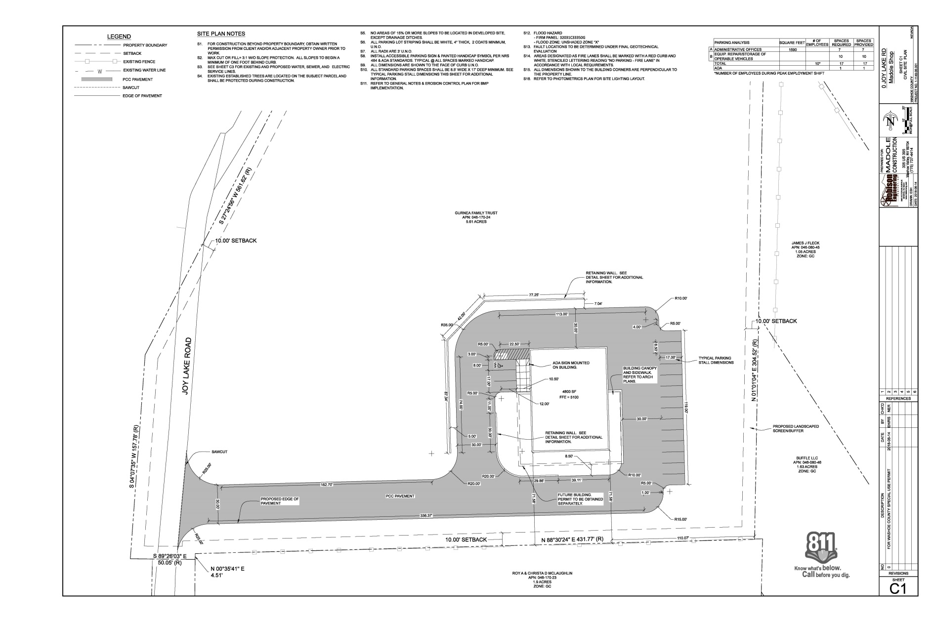
Site Plan

Slide 8
Agency Review and Noticing
4 of the 10 reviewing agencies provided comments and conditions
32 property owners were noticed

Slide 9
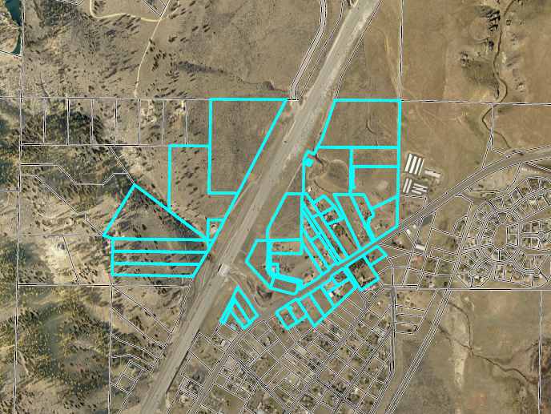
Noticing Map

Slide 10
STM/WV CAB
The project was presented to the South Truckee Meadows/Washoe Valley CAB on July 5th
The CAB unanimously recommended that the SUP move forward to the Board of Adjustment

Slide 11
Possible Motion
I move that, after giving reasoned consideration to the information contained in the staff report and information received during the public hearing, the Washoe County Board of Adjustment approve with the conditions contained in Exhibit A to this matter, and the modifications to WCC Section 110.412.40 (b) Required Yards Adjoining Streets, WCC Section 110.512.40 (c) Landscape Buffers Adjoining Residential Uses, and WCC Section 110.412.40 (d) Screening Adjoining Residential Uses, for Special Use Permit Case Number WSUP18-0014 for Madole Construction, having made all five findings in accordance with Washoe County Code Section 110.810.30, and the two findings in accordance with the South Valleys Area Plan:

